Slide 1


Capstone Project on Data Warehouse Design and ETL Implementation Using Informatica
US CHRONIC
DISEASE INDICATOR
By: Kruthik Ballari

Slide 2


Overview
PROBLEM STATEMENT
03
Dataset Description
04
Process Steps for Flowchart
06
DATABASE DESIGN SCHEMA
07
FACT TABLE SCD 2
08
FINAL WORKFLOW MANAGER
09
FINAL WORKFLOW MONITOR
10
WEBSITE INTERFACE
11
VISUALIZATIONS
12

Slide 3
PROBLEM STATEMENT
This is a scalable data warehouse design project aiming at the solution to the problem of complex and voluminous dataset analysis and the derivation of actionable insights from those datasets. Due to an increased demand in businesses for efficient mechanisms in data storage and processing, this capstone project is about building a reliable ETL pipeline using Informatica on transforming raw data into structured information housed within a well-designed data warehouse. The solution will be identifying relevant dimensions and facts, modeling the data warehouse schema, and implementing ETL workflows that ensure data accuracy, consistency, and scalability. Finally, SQL-based queries will be used to extract meaningful insights to support business decision-making processes.

Slide 4
DATASET DESCRIPTION
US Chronic Disease Indicator Dataset
The US Chronic Disease Indicator dataset is a comprehensive data source that provides information on the prevalence and incidence of chronic diseases within the United States. This dataset typically includes key health indicators related to conditions such as diabetes, cardiovascular diseases, obesity, cancer, and respiratory diseases. The data is collected and reported by health agencies and public health departments to monitor trends, support policy-making, and improve public health interventions.

Slide 5
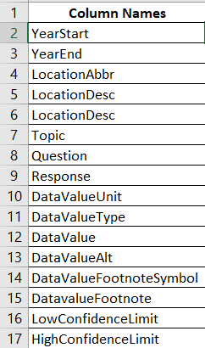
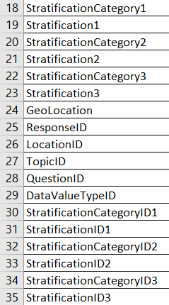
DATASET DESCRIPTION
Total Columns: 34
Total Data Rows: 11,85,676
Source Type: CSV ( Comma Delimited )

Slide 6








PROCESS STEPS FOR FLOWCHART
STEP 1
STEP 2
STEP 3
STEP 4
STEP 5
STEP 6
Data Loading into Warehouse
Data Understanding and Analysis
Data Modeling
ETL Strategy Definition
Staging Area Setup
ETL Development
Documentation
Data Analysis and Reporting
STEP 8
STEP 7

Slide 7

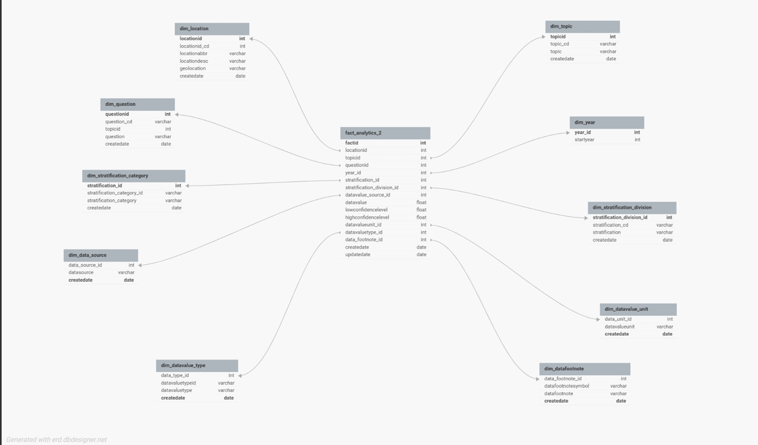

DATABASE DESIGN SCHEMA ( DIM TABLES & FACT TABLES)

Slide 8
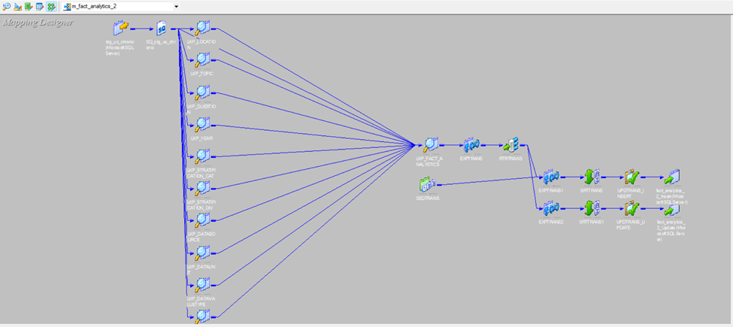
FACT TABLE SCD 2 IMPLEMENTATION

Slide 9
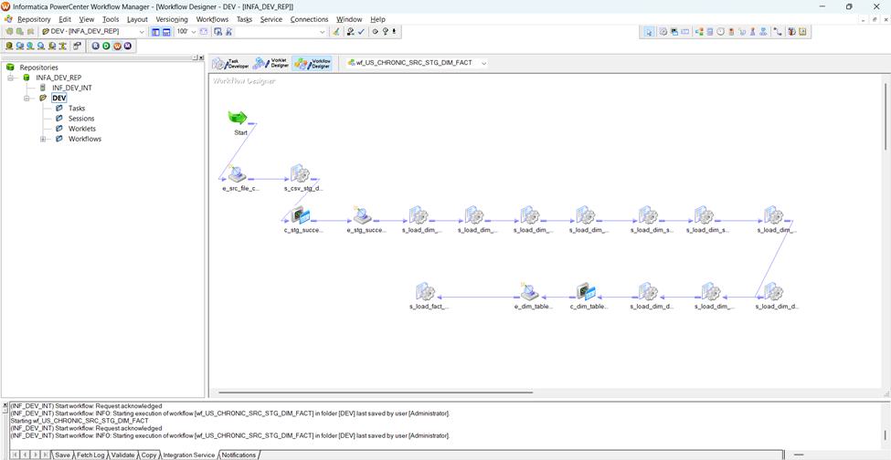
FINAL WORKFLOW MANAGER

Slide 10
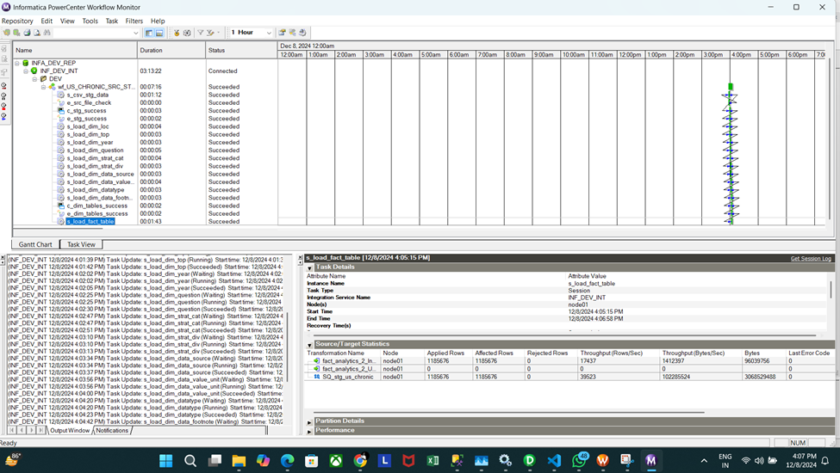
FINAL WORKFLOW MONITOR

Slide 11
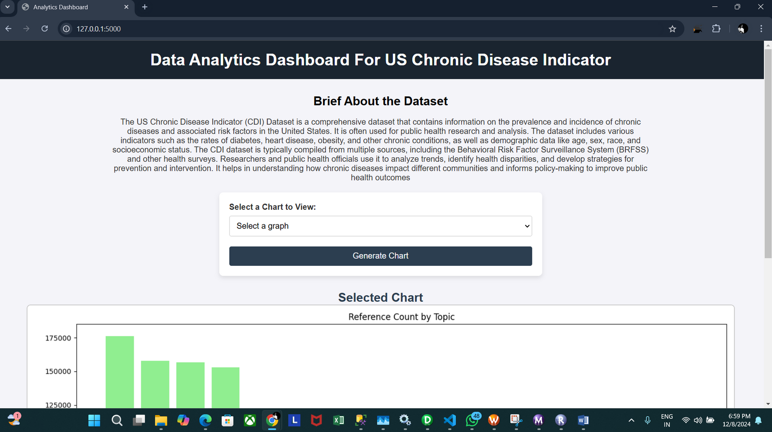
WEBSITE USER-INTERFACE FOR VISUALIZATION

Slide 12
Visualizations
Using Python Flask and SQL Alchemy
Alcohol Use Among Youth by Race Ethnicity in 2019 under Crude Prevalenceragraph text
Chronic liver disease mortality in California in 2013
Reference Count
Topics Distribution
Year Distribution

Slide 13
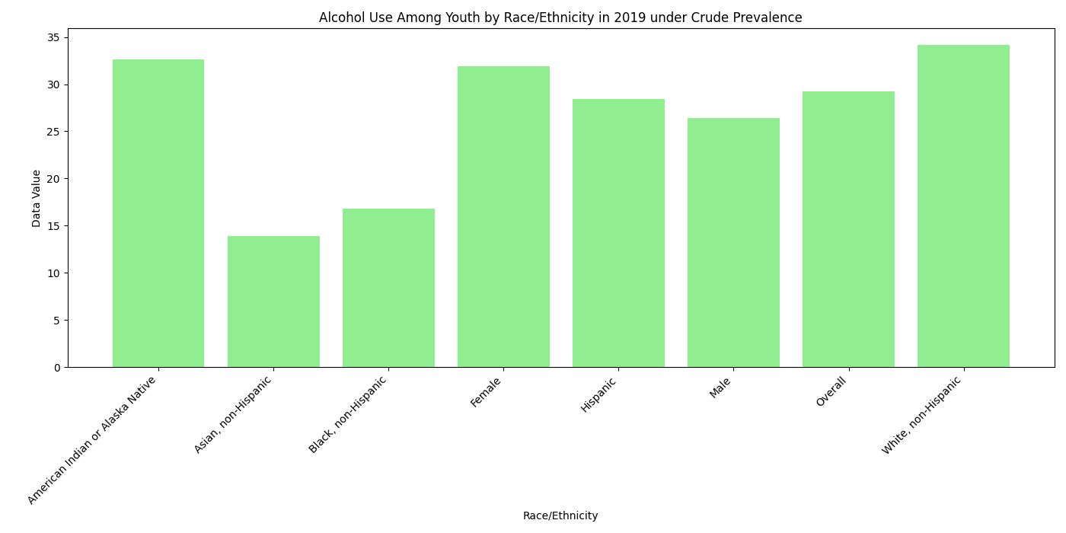
Alcohol Use Among Youth by Race Ethnicity in 2019 under Crude Prevalence

Slide 14
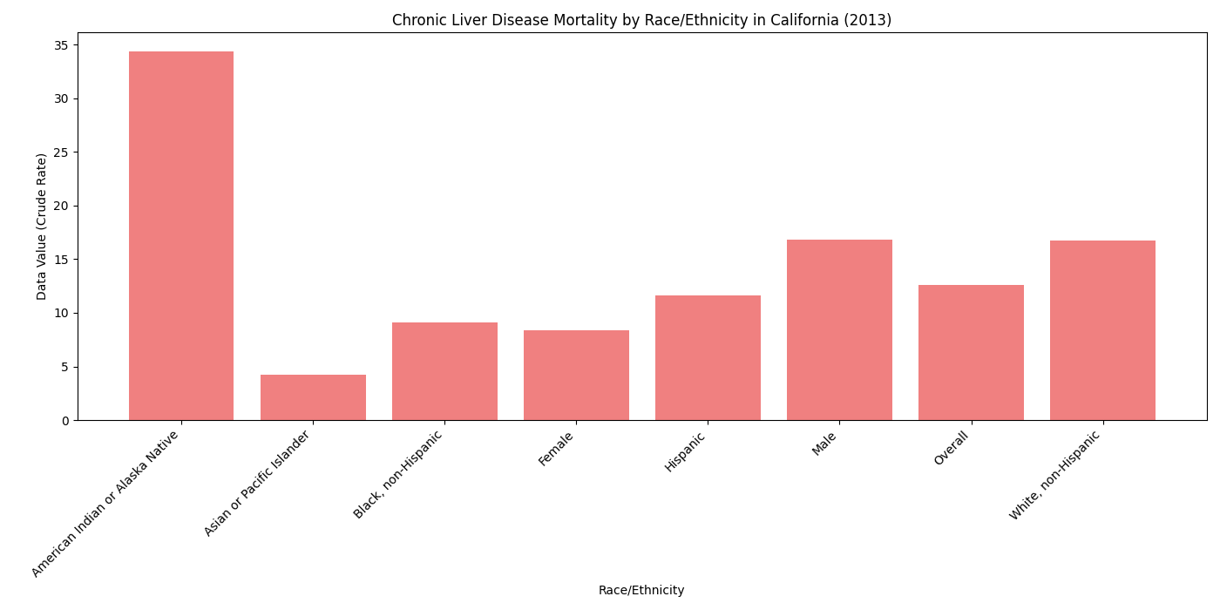
Chronic liver disease mortality in California in 2013

Slide 15
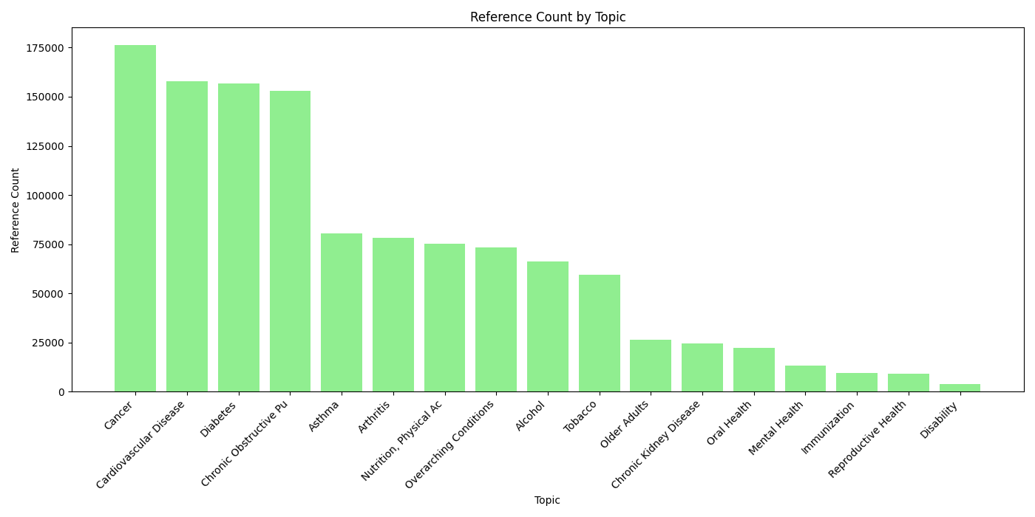
Reference Count

Slide 16
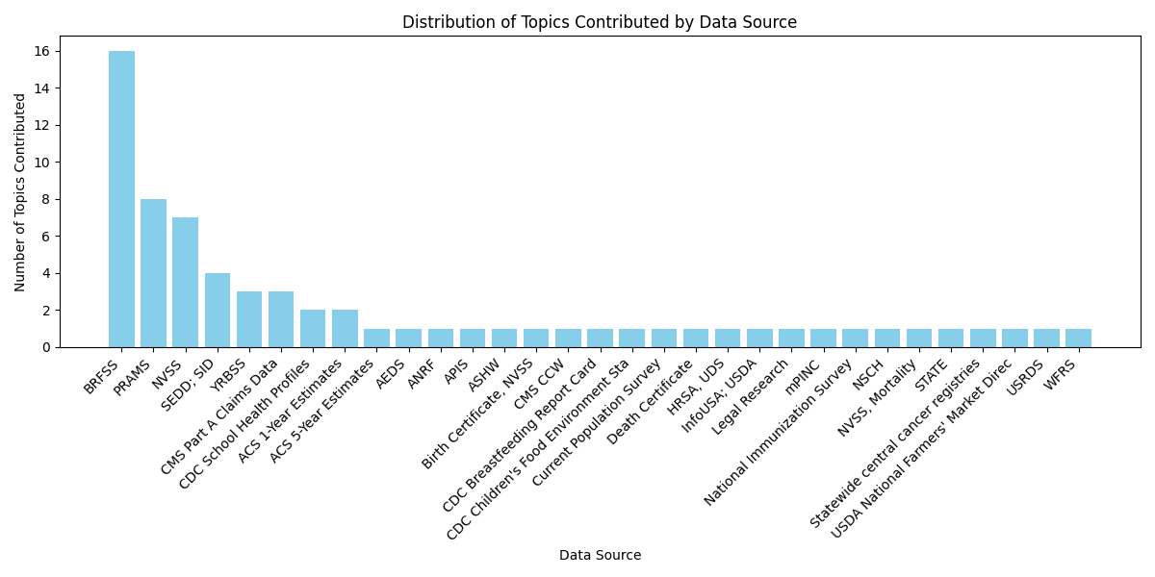
Topics Distribution

Slide 17
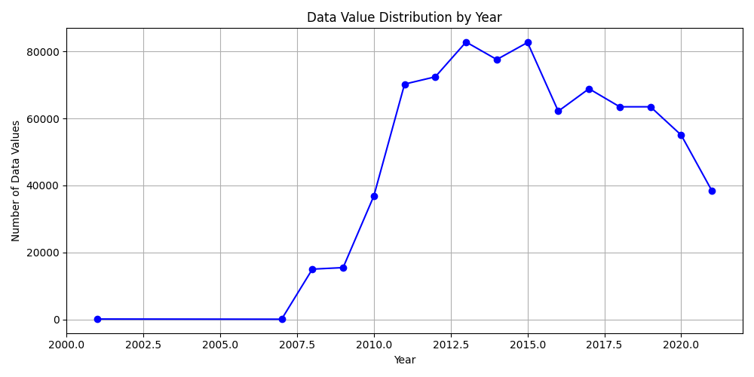
Year Distribution

Slide 18

Capstone Project on Data Warehouse Design and ETL Implementation Using Informatica
THANK YOU!
KRUTHIK BALLARI

